Slide 1
Frontline
CLIQZ for Firefox
++

Slide 2




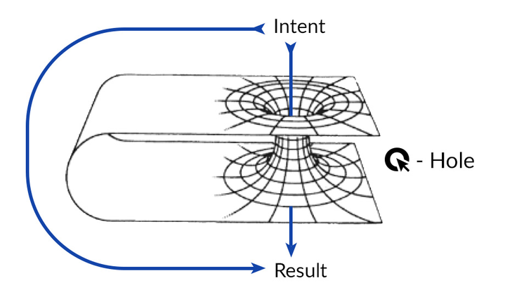

CLIQZ for Firefox
What some people think we do
What our parents think we do
What Google thinks we do
What our friends think we do
What we think we do
What we really do
Notes:
What do we really do?

Slide 3

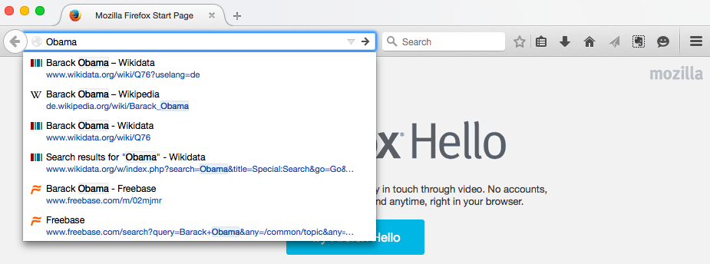

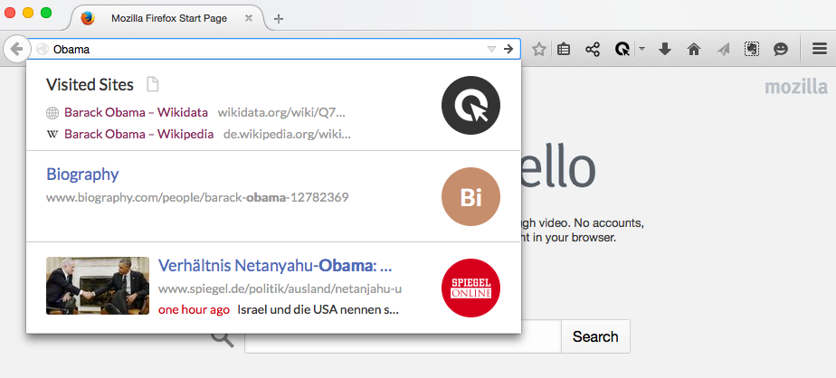
Default
Firefox
CLIQZ

Slide 4




Static
resources
CDN
uCrawl
Write
Telemetry
S3
Querylog
Extension
Mixer
Big Machine
Rich Header
News
Notes:
CLIQZ for Firefox in a bigger picture

Slide 5
Browser Extension ?
Themes
Language packs
Firefox
Add-ons
Plugins (Acrobat reader, Java, Flash,…)
Traditional
Extensions
Add-on SDK
Bootstrapped

Slide 6
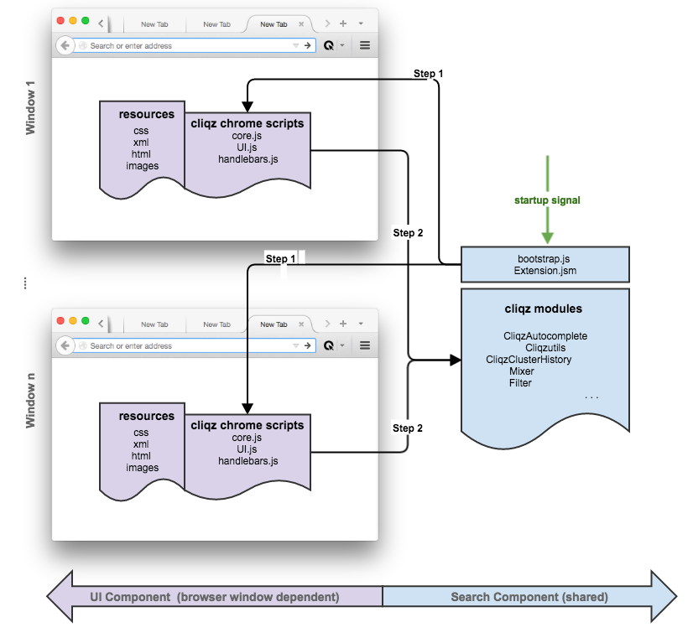
Notes:
How it works

Slide 7
History
Pattern
Cluster
CliqzAutocomplete
Generic
GO Mixer
Mixer
Deduplicator
Notes:
Cluster – github

Slide 8
☺
Questions?

